Slide 1






ST. ILLTYD’S PRIMARY SCHOOL
Curriculum Summary
2023-2024

Slide 2

Our Vision and Mission
Our mission statement is that we, here at St Illtyd's, will always aim to be our BEST...
Believe - We should ‘Believe’ in ourselves and each other.
Enrich - We need to be immersed and ‘Enriched’ in our daily lives and in our learning.
Succeed - We want all of our children and staff to ‘Succeed’.
Together - We believe in working ‘Together’, staff, children, parents, Governors and the local community, to achieve our best.
This has been agreed by all staff, learners and key stakeholders.

Slide 3

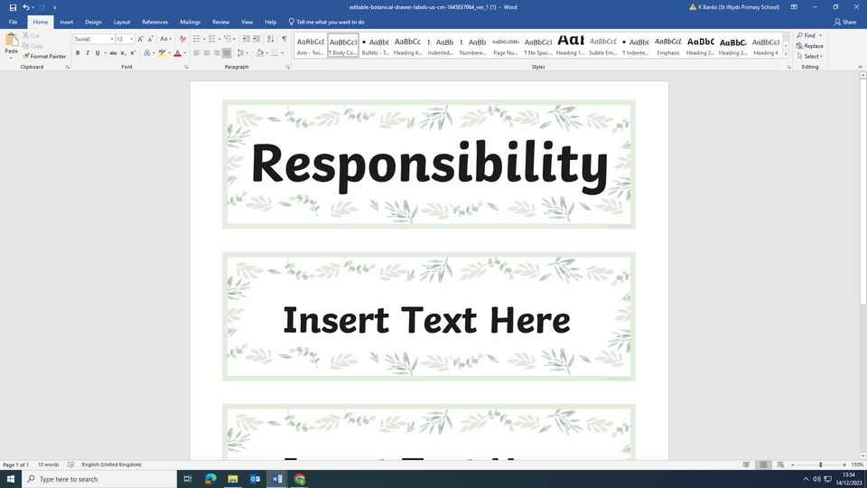
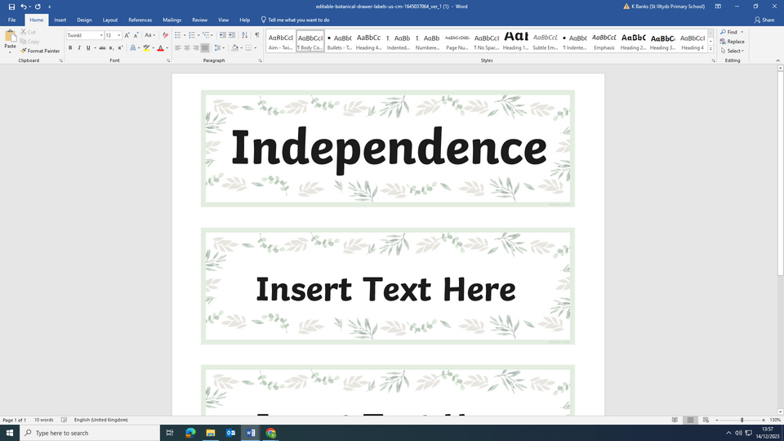
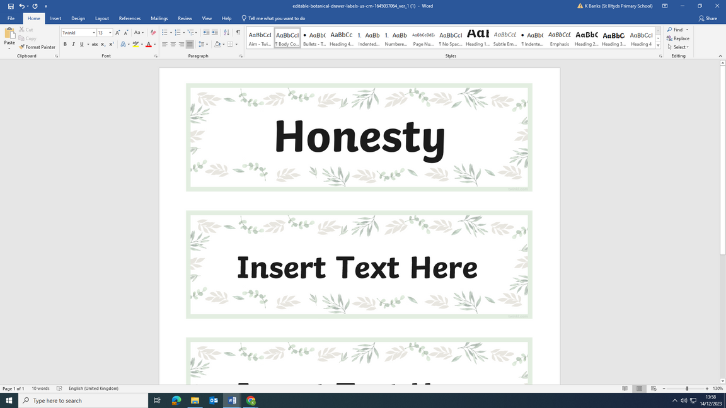
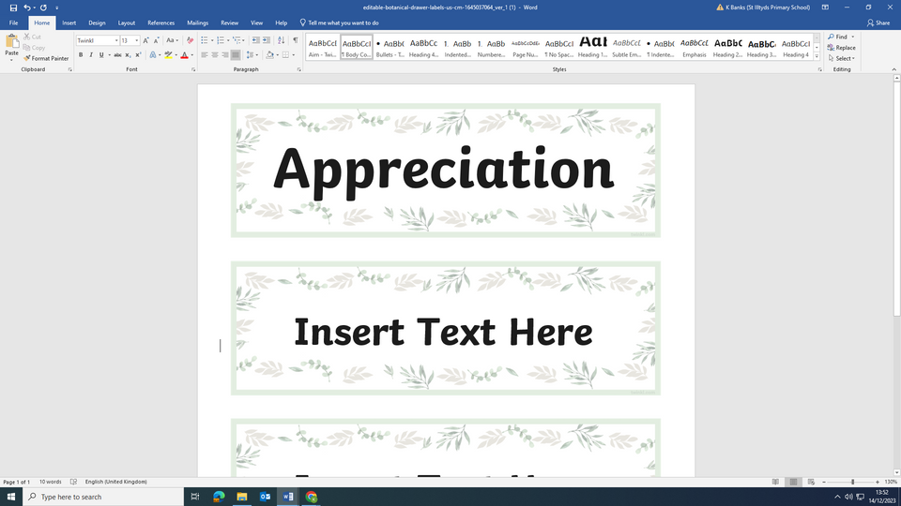



Our Values
When Creating our values, we asked our staff and families:
“What are your hopes for your child during their time at St.Illtyd's?”
“What are your hopes for your child‘s future as they move to Secondary school and beyond?”
From this feedback, we decided that these 6 Values would be central to our curriculum design.

Slide 4
Our Curriculum
Our curriculum is structured around:
Six interconnected areas of learning (AoLEs)
Languages, Literacy and Communication
Mathematics and Numeracy
Science and Technology
Humanities
Health and Well-being
Expressive Arts
Four Purposes
Ambitious, capable learners
Enterprising, creative contributors
Ethical, informed citizens
Healthy, confident individuals
Cross-curricular Skills
We develop essential skills including literacy, numeracy, digital competence, critical thinking, and creativity across our curriculum.
Assessment for Growth
We believe in assessment as a tool for learning, not just a measure of it. We focus on formative assessment practices that provide meaningful feedback, encourage reflection, and celebrate progress alongside achievements. Learners are involved throught the progress and are encouraged to take ownership of their learning and identify their strengths and areas for development.

Slide 5


Curriculum Design
When considering the Curriculum for Wales, the staff of St.Illtyd’s Primary School worked to unpick and address the implementation in continuously evolving stages.
Stage 1: Research! Staff spent time working collaboratively and undertaking research projects to answer the questions; What does the Curriculum mean to us as a school? What is the purpose and rationale behind the change? How can we implement the change successfully?
Stage 2: From here, we invited our key stakeholders to help us create our school vision and determine the values that would be held at the heart of the curriculum.
Stage 3: We reflected on how the Four Purposes would be central to the planning and delivery of our curriculum and how our pupil offer would be enhanced to encompass all of the Areas of Learning and Experience (AoLE). A team was created around each AoLE to ensure breadth and balance to our curriculum.
Stage 4: Designing our bespoke Curriculum in collaboration with cluster representatives, we explored the What Matters Statements for each AoLE and what progression will look like for our learners. AoLE leads created a toolkit bespoke to our school.

Slide 6

Aims
At St.Illtyd’s Primary, we aspire to:
  Develop young people who are confident, resilient and ready to face the challenges of the 21st century.
  Nurture a love of learning that lasts a lifetime.
  Equip learners with the skills and knowledge they need to be successful in life and work.
  Promote Wales' unique culture and language, while also preparing young people for a globalised world.
We strive to:
  Ensure all learners have equal opportunities to succeed.
  Promote inclusivity and celebrate diversity.
  Foster a love of learning through engaging and active learning experiences.
  Connect learning to real-world contexts and issues.
  Prepare learners for further education, employment, and lifelong learning.

Slide 7
Embracing
The Four Purposes
Our Guiding Vision
At St.Illtyd’s Primary, we are committed to nurturing ambitious, capable learners, enterprising, creative contributors, ethical, informed citizens of Wales and the world, and healthy, confident individuals ready to lead fulfilling lives. These four purposes, enshrined in the Curriculum for Wales, frame every aspect of our educational journey.
Cultivating the Four Purposes
Ambitious, Capable Learners: We ignite curiosity, encourage lifelong learning, and empower students to take ownership of their education.
Enterprising, Creative Contributors: We nurture problem-solving skills, collaboration, critical thinking, and ingenuity to prepare students for a world of possibilities.
Ethical, Informed Citizens: We foster respect for diversity, empathy, responsible decision-making, and active engagement in local and global communities.
Healthy, Confident Individuals: We prioritise physical and mental well-being, emotional literacy, and resilience to equip students for a fulfilling life.

Slide 8
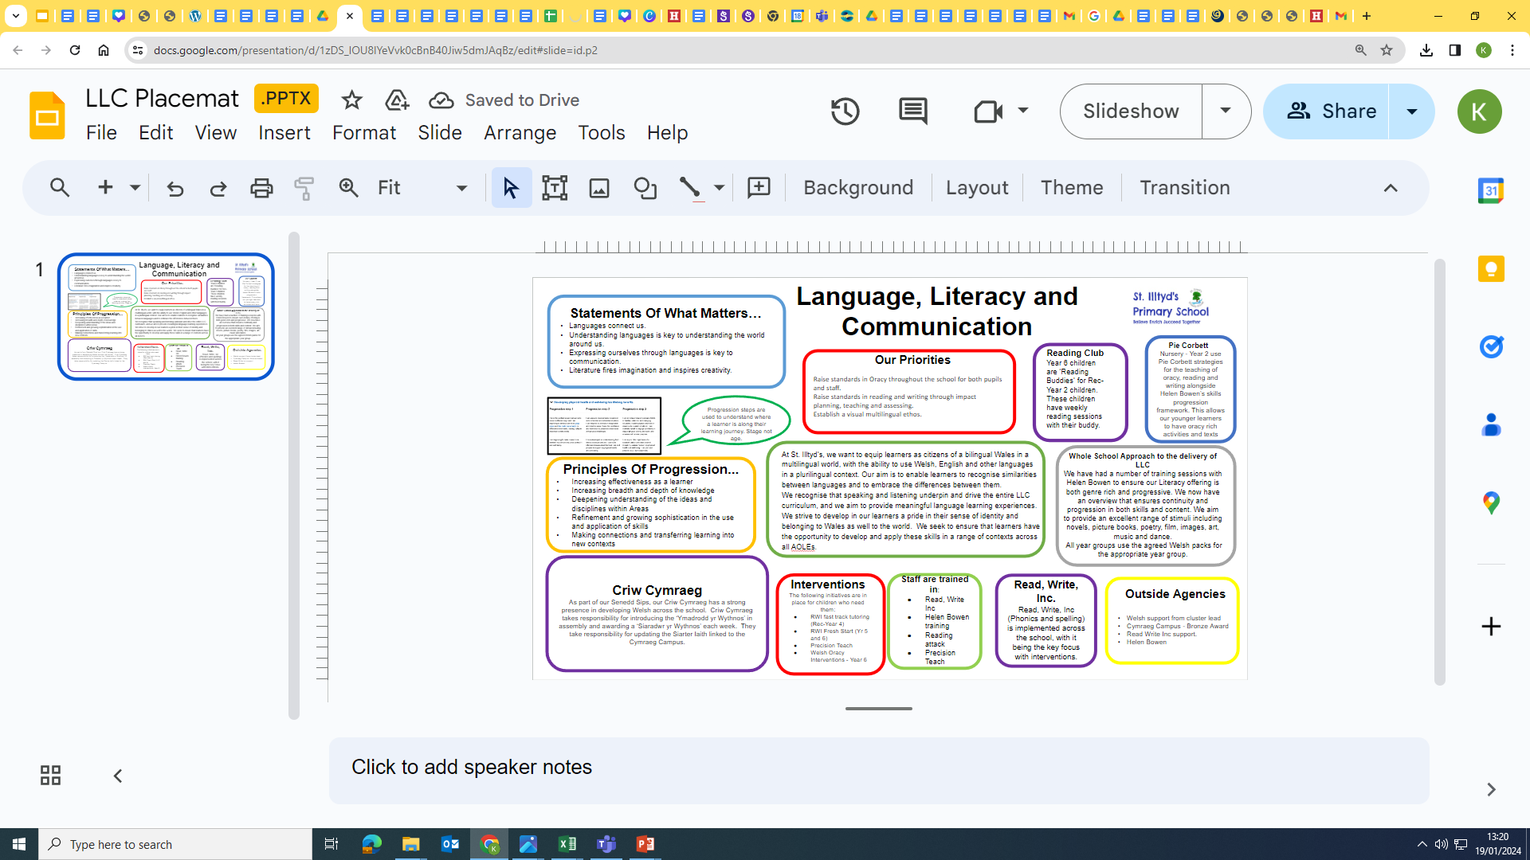
Area’s of Learning Experience (AoLE)
As part of our Curriculum design, each AoLE Team created a Placemat of provision taking into consideration the What Matters Statements, assessment opportunities and progression for all.
Languages, Literacy and Communication

Slide 9
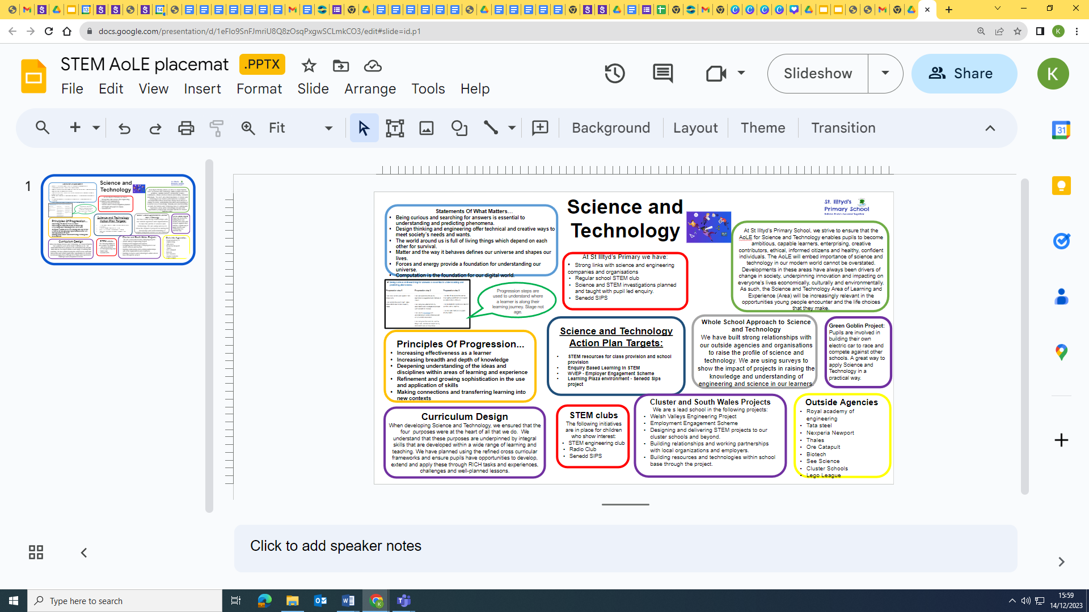
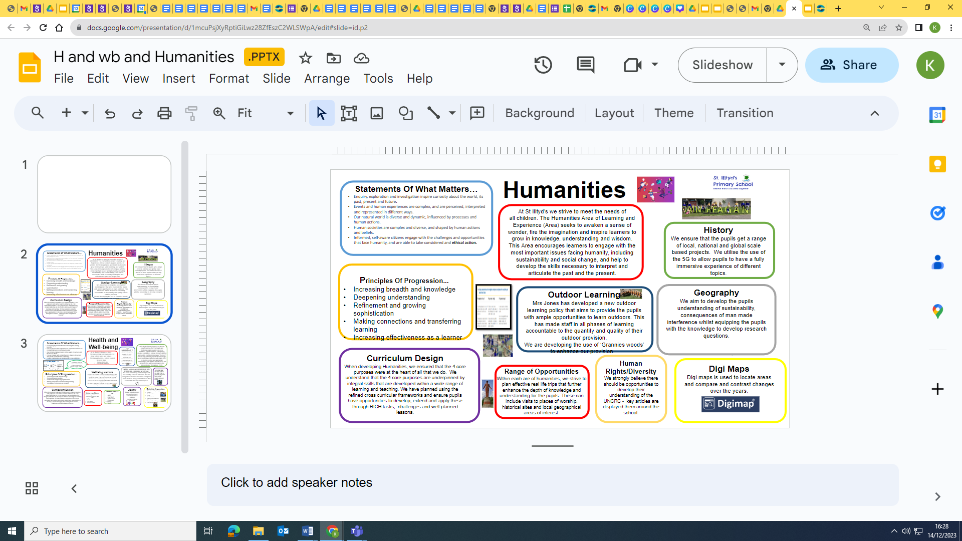
Science and Technology
Humanities

Slide 10
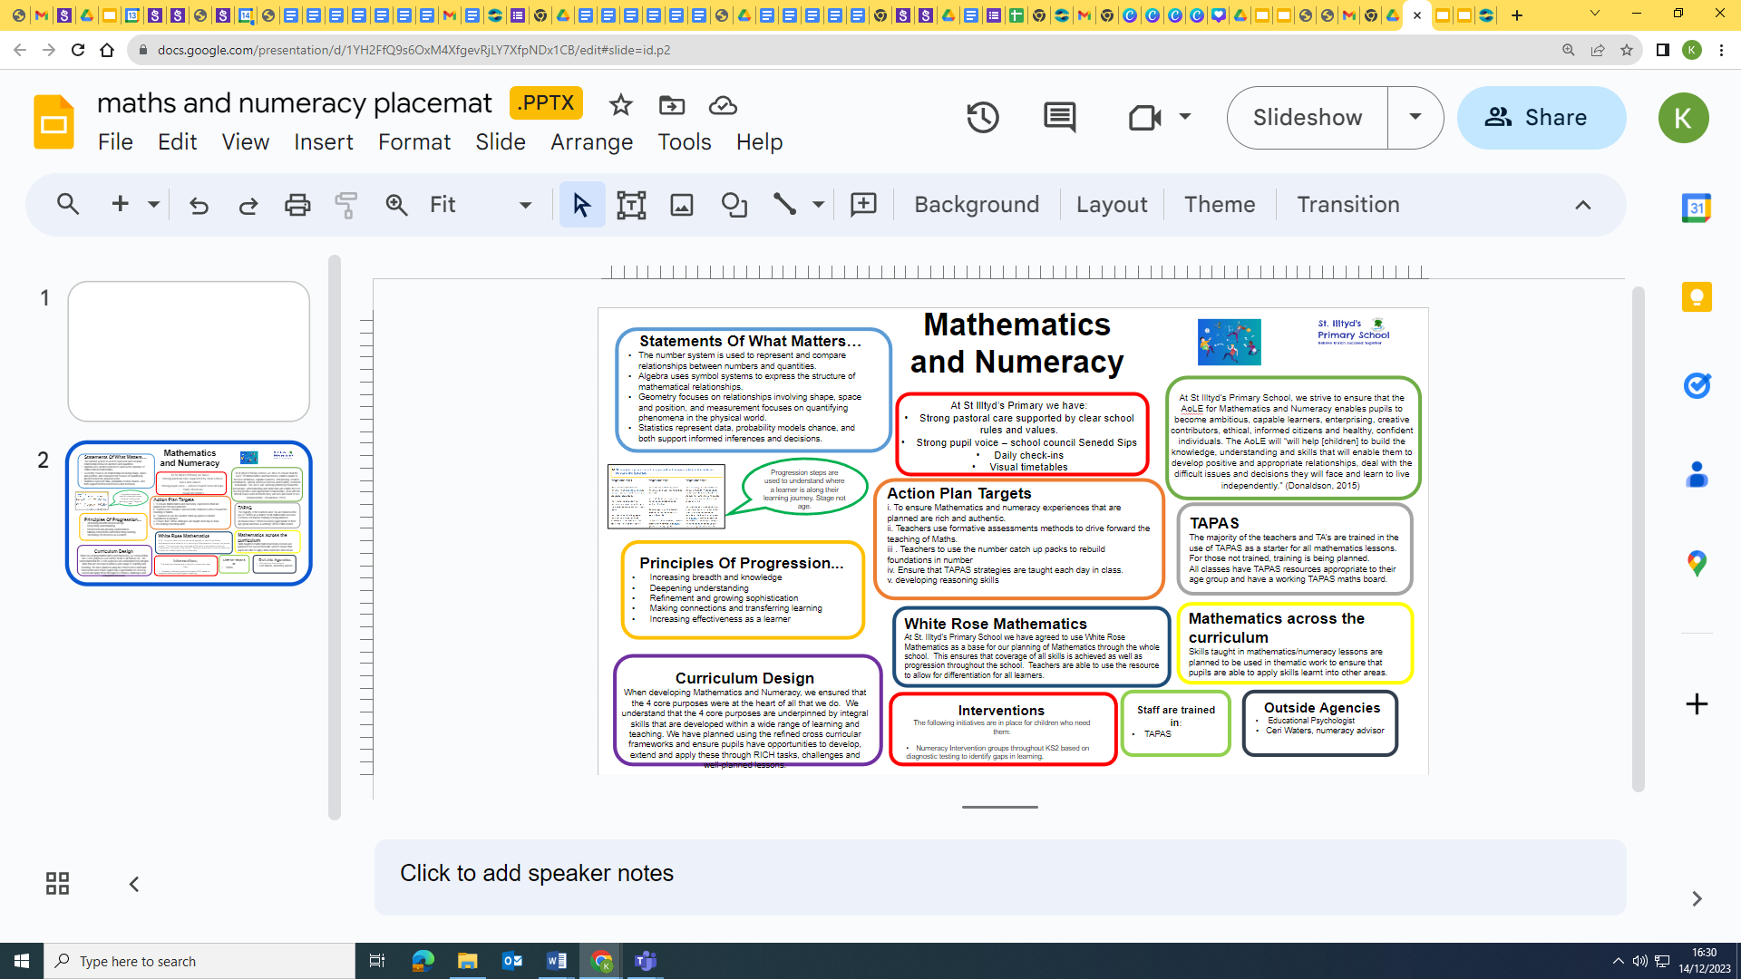
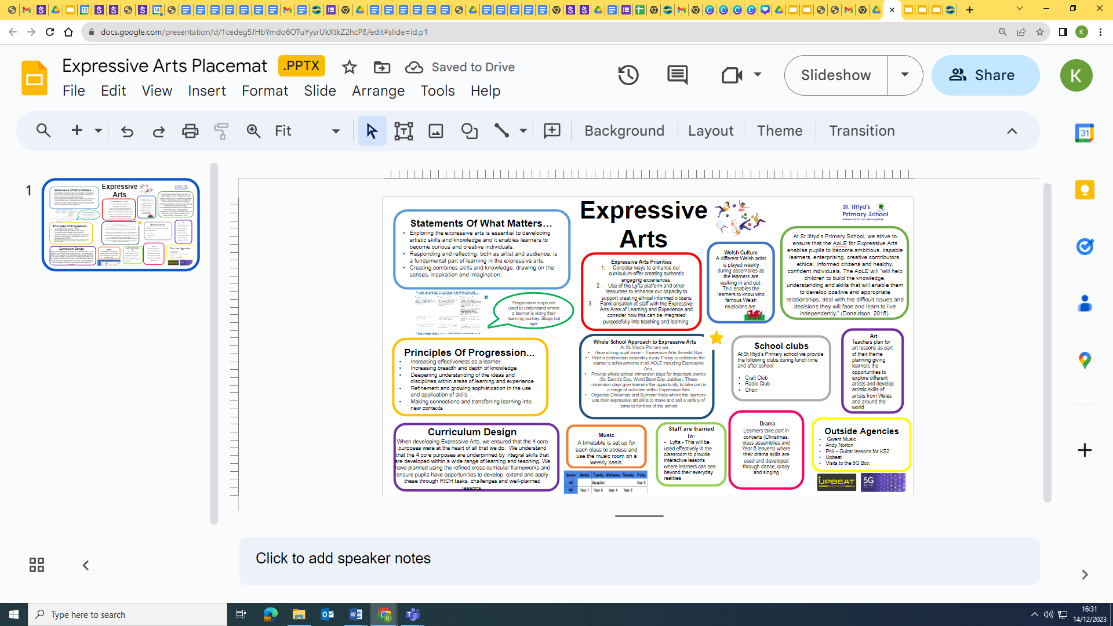
Mathematics and Numeracy
Expressive Arts

Slide 11
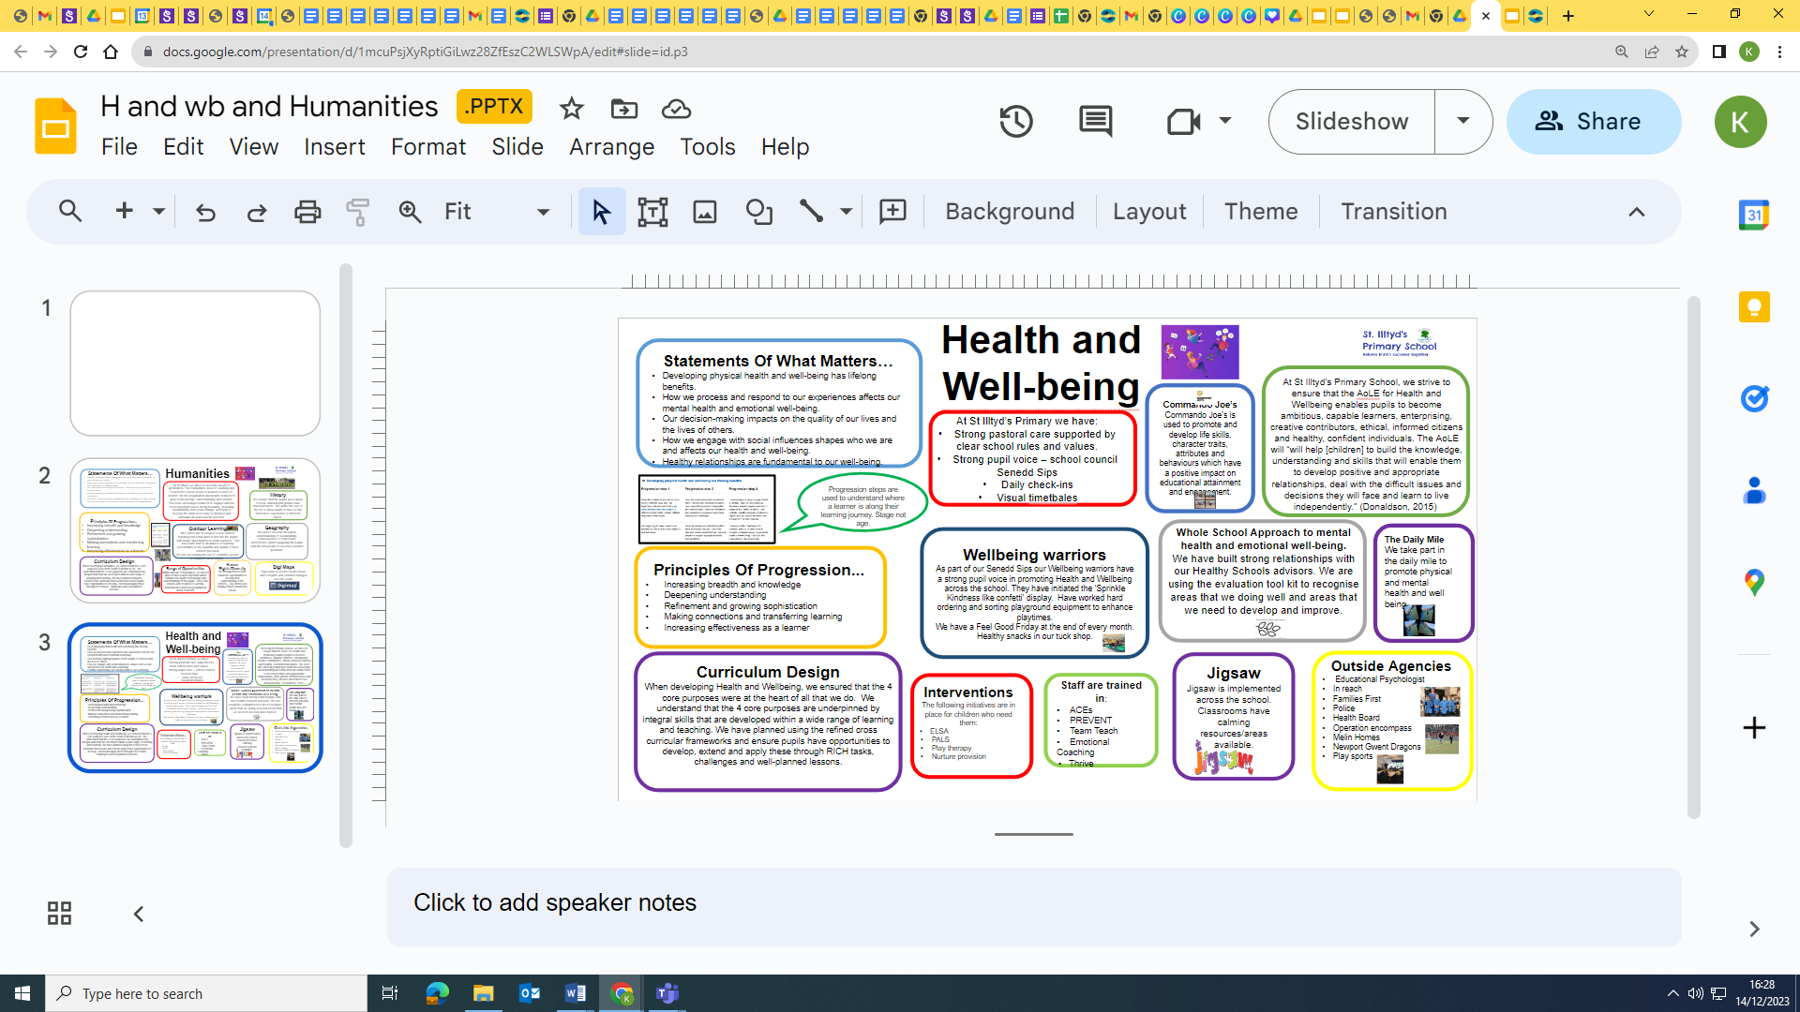

Health and Well-Being
Learning Beyond the Classroom
We embrace authentic learning experiences that extend beyond the classroom walls. From field trips and community projects to partnerships with local businesses and cultural organizations, we provide opportunities for students to apply their knowledge in real-world contexts.

Slide 12
In Summary
Our school curriculum is more than just a set of subjects and topics. It's a journey of discovery, exploration, and empowerment. We believe that every learner can thrive when equipped with the knowledge, skills, and values outlined in the Curriculum for Wales. By embracing the Four Purposes, we aim to prepare our students to become well-rounded individuals who are ready to make a positive difference in the world.
We acknowledge the vital role of families and the community in our learners success. We build strong partnerships, fostering open communication and work together to ensure every child thrives.
At St.Illtyd’s Primary School, we are dedicated to providing a dynamic and transformative learning environment that empowers our learners to become successful, well-rounded individuals, ready to contribute positively to Wales and the world.

